Slide 1
Odometer Mileage Extraction
Implementing an innovative way to obtain car mileage
Notes:
Adam O.

Slide 2
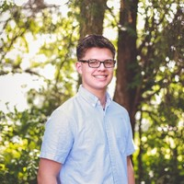
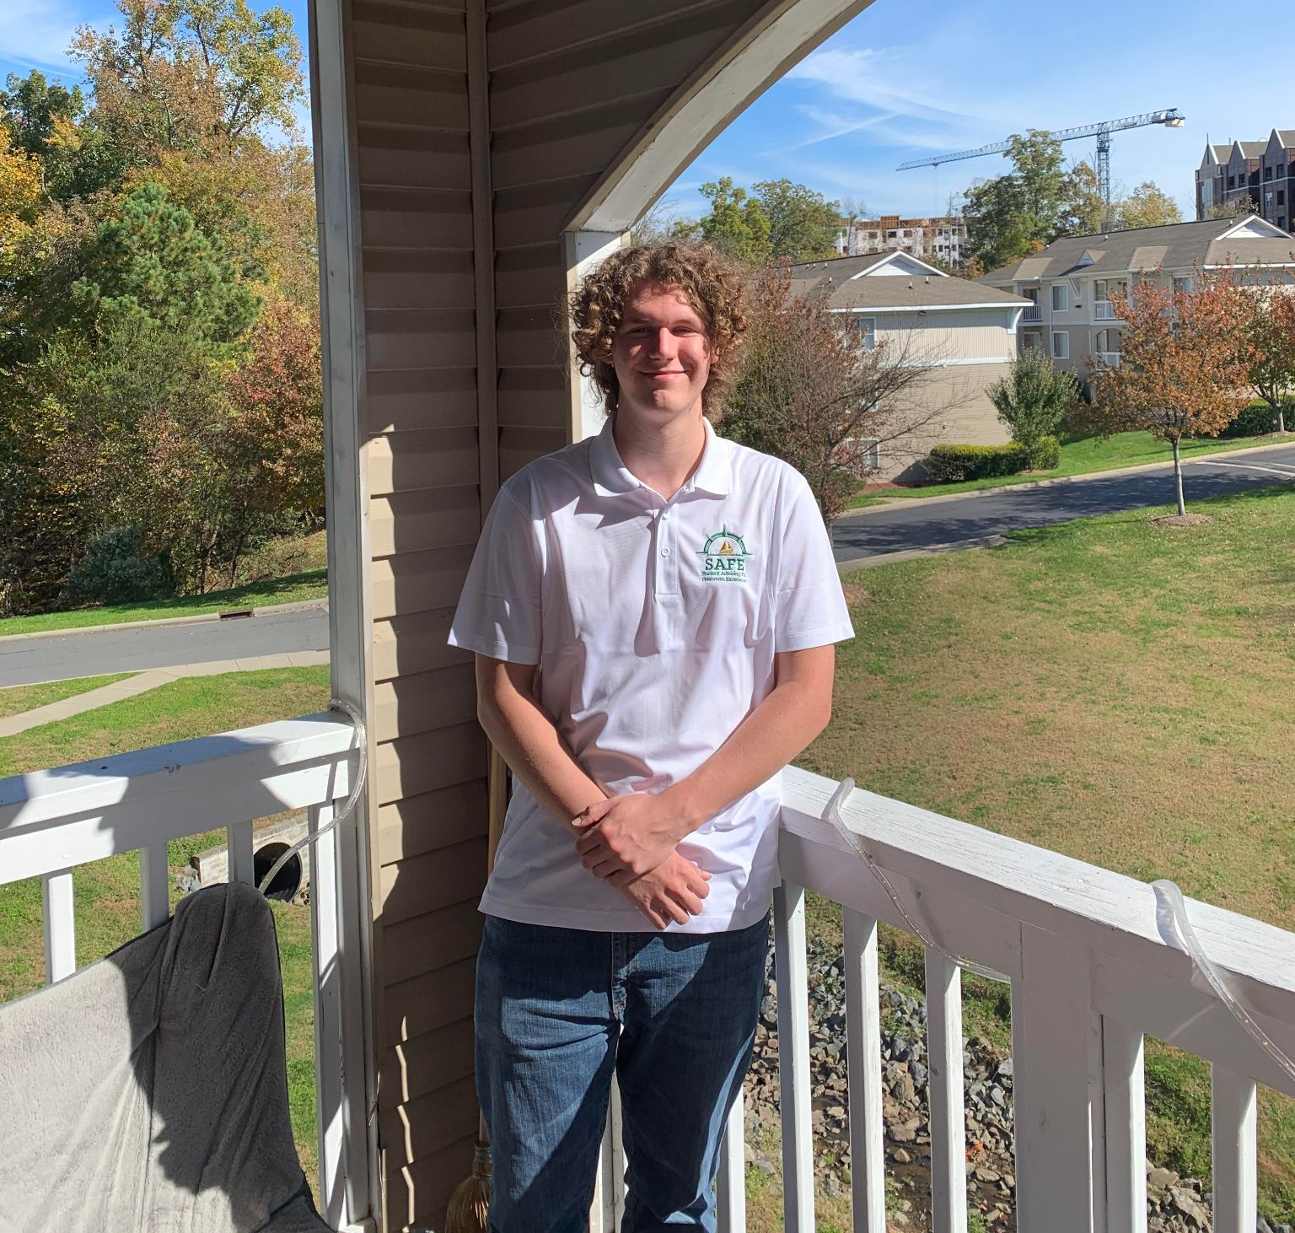
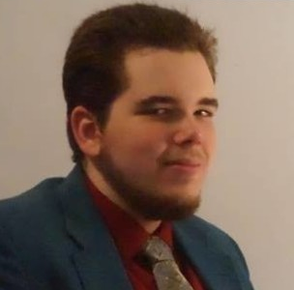
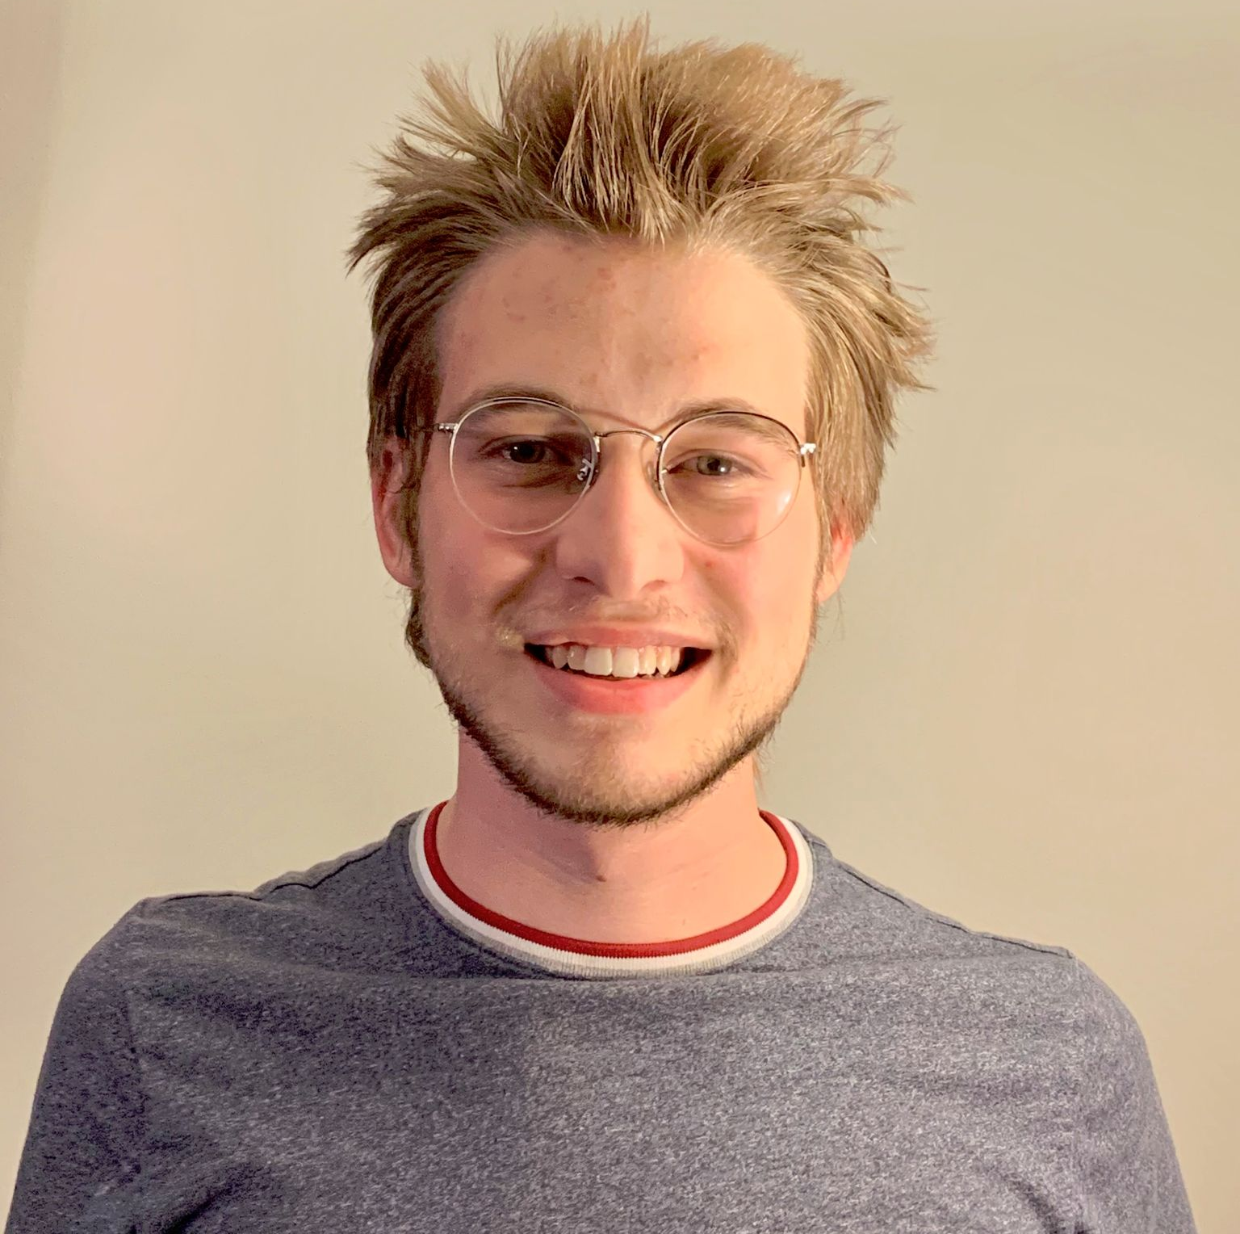
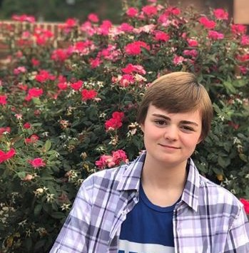
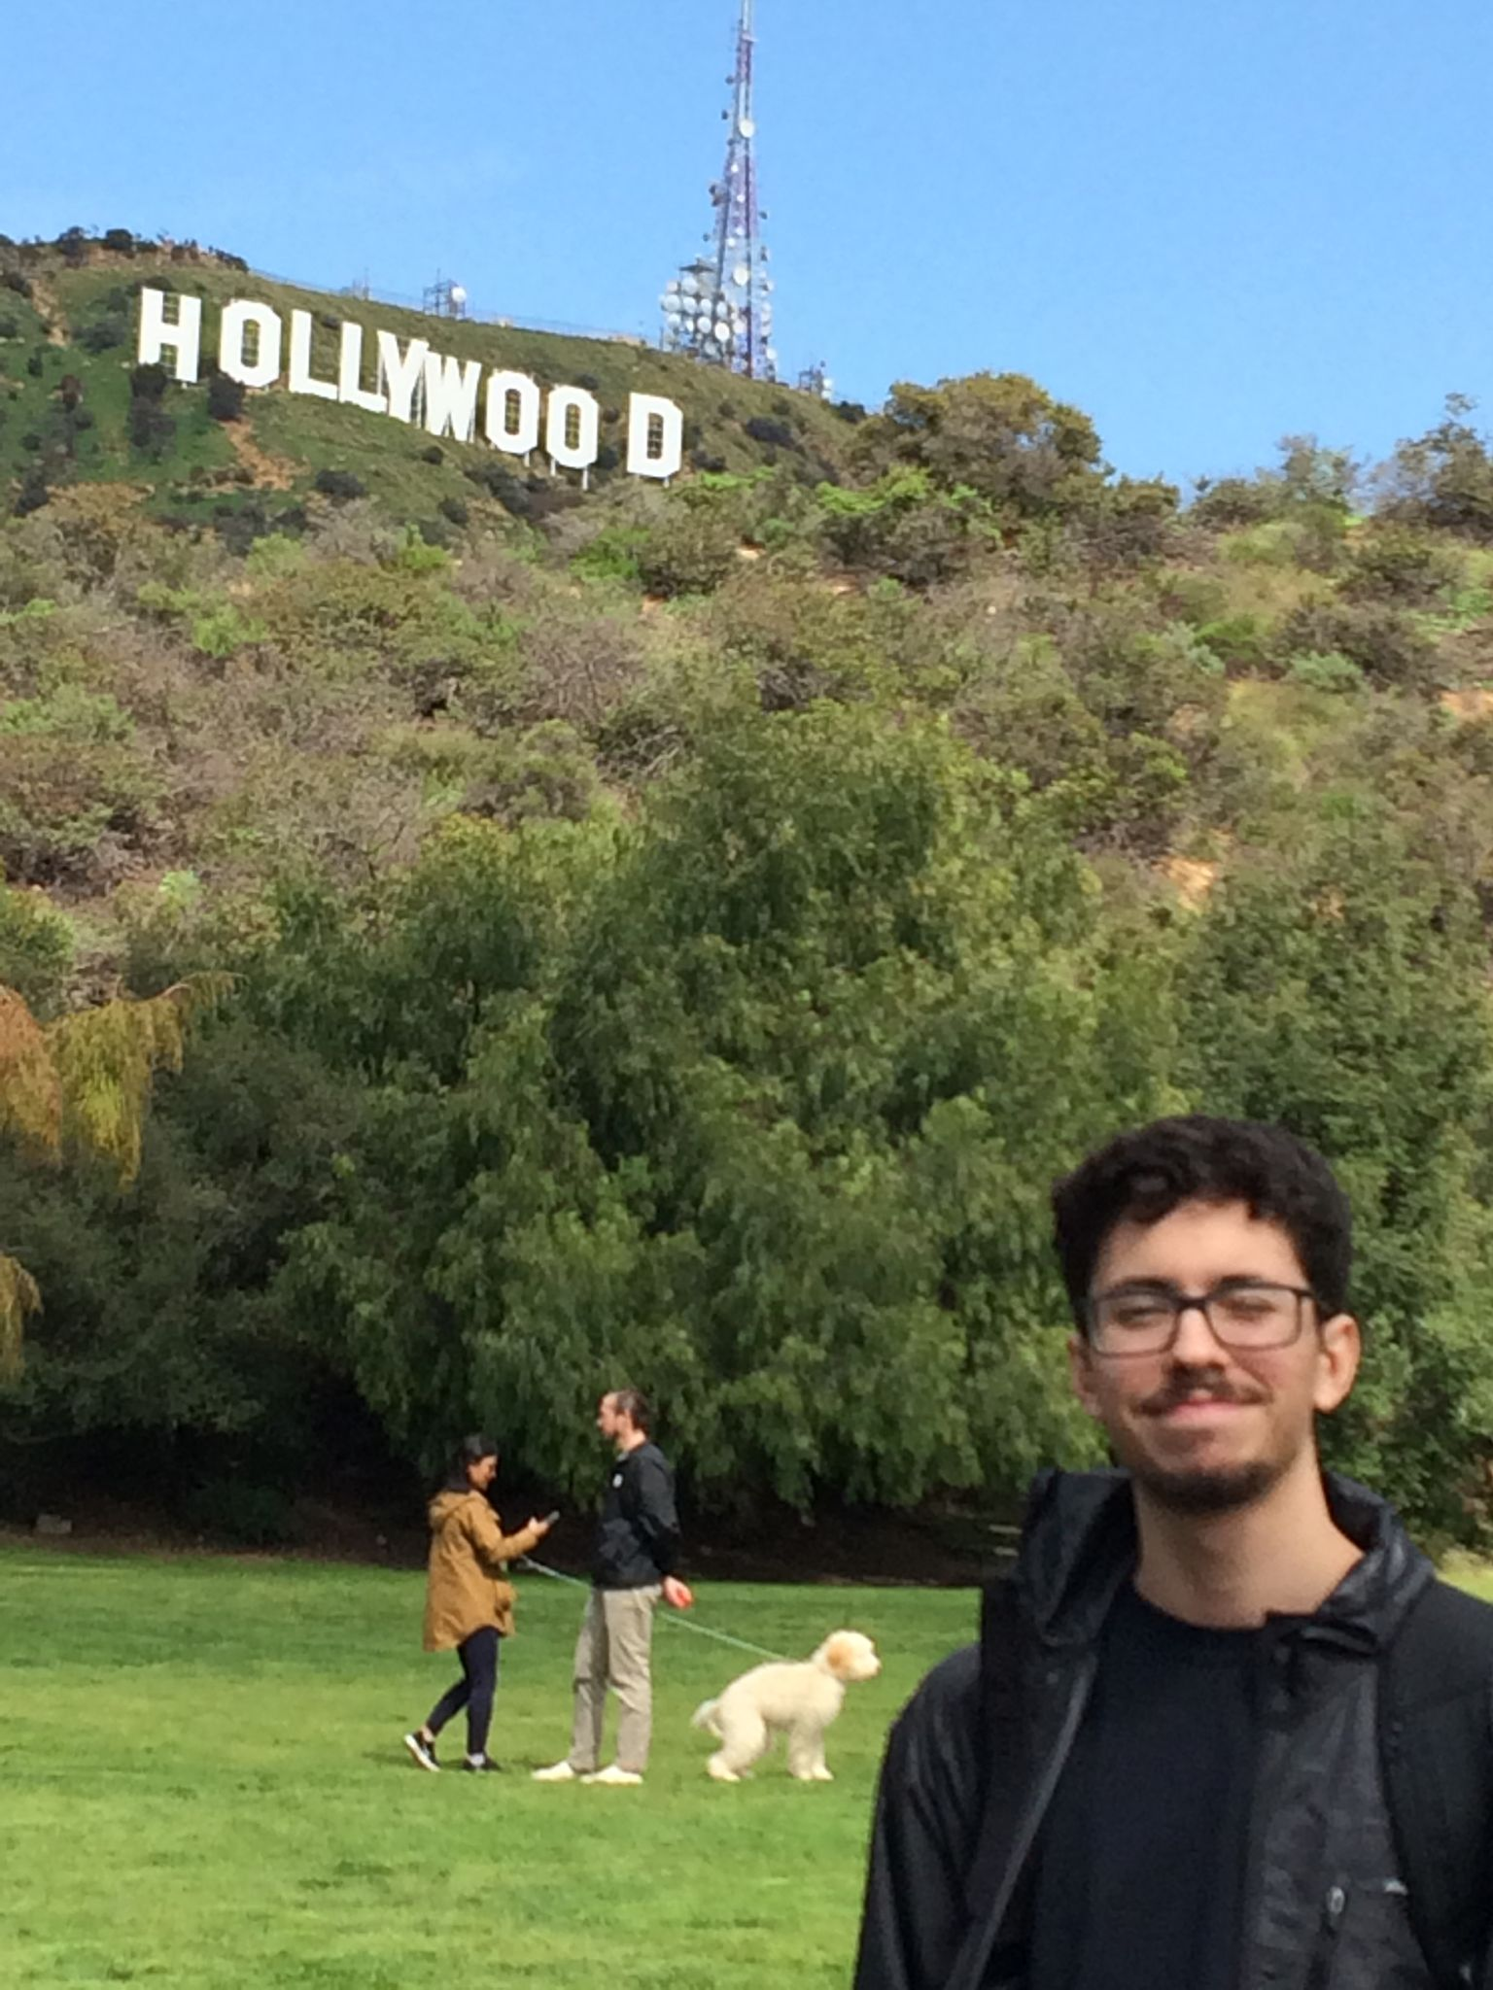
Team Members - Adam
Adam O’Malley
Derrick Zipperer
Austin Lowery
Nathan Ferragut
Nick Ladensack
Ed Nava
Notes:
Adam O.

Slide 3

Problem Statement - Adam
Our group’s focus will be tackling the problem given to us by Sonic Automotive,
extracting mileage data from Odometer readings.
Notes:
Adam O.

Slide 4
Identifying the Problem- Adam
Sonic Automotive had a problem:
Incorrect mileage input due to human error
Mass volume of vehicles required manual input
Time Consuming and Labor Intensive
Causes slow vehicle processing
Sonic has a Large Customer Base
Possible loss of profit
Must pay for data entry labor
Notes:
Adam O.

Slide 5
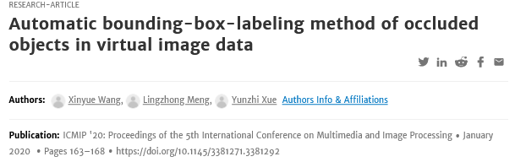
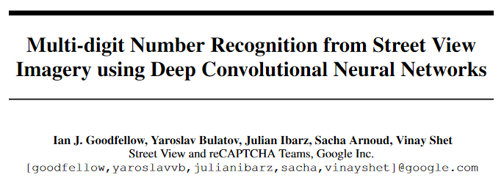
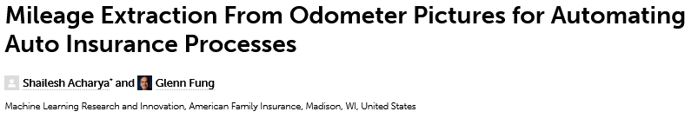
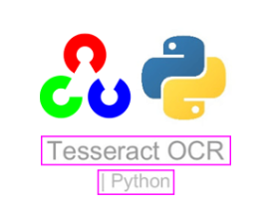

Research - Nathan
Notes:
Nathan

Slide 6
Our Solution:
Notes:
Nathan

Slide 7
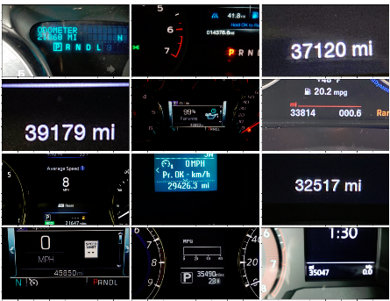
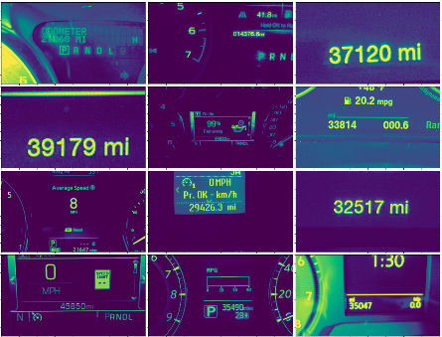
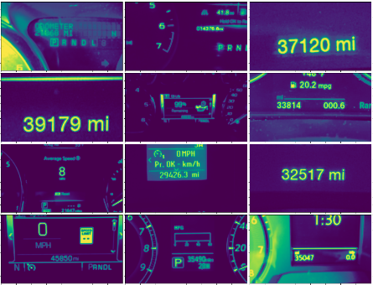
Pre-processing Images - Nathan
Original Images
Converted to Grayscale
Gaussian Blur
Notes:
Nathan

Slide 8
Utilizing RCNN - Nathan
Bounding box implementation required the use of an RCNN:
MaskRCNN or FastRCNN
Decided upon FastRCNN to account for a faster runtime
Efficient way of automatically finding bounding boxes
Multiple Models that utilized FastRCNN that are widely accessible
We filtered down our options to 2 models
Detectron2 and Yolov5

Slide 9
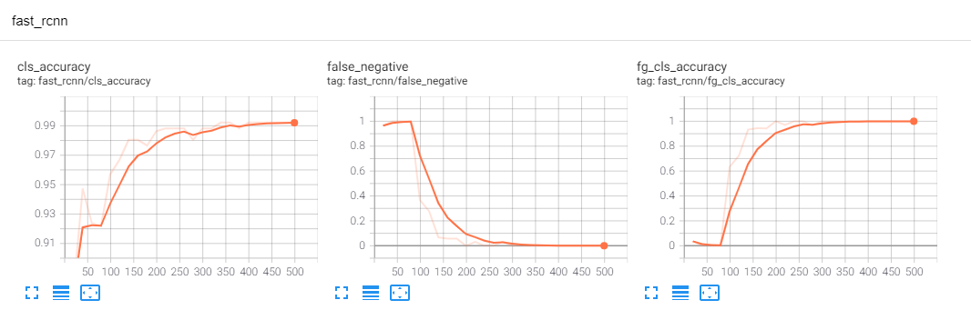
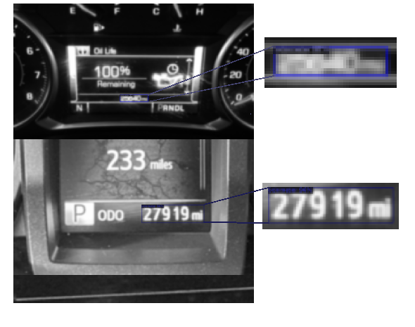
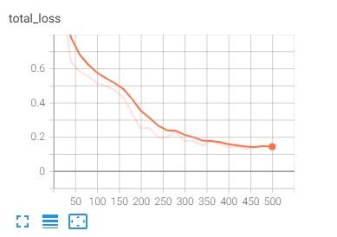
Overall Performance of Program - Ed

Slide 10
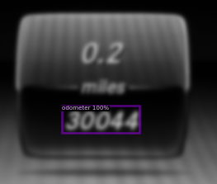
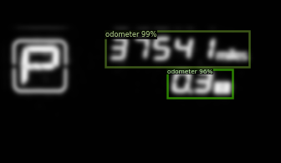
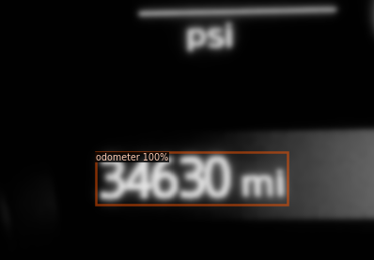
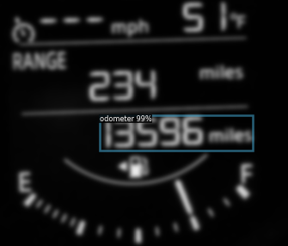
Overall Performance of Program - Derrick
Non-Filtered Data
6/23 images do not show an odometer prediction (Model was not more than 80% confident)
Filtered Data
All images show an odometer prediction

Slide 11
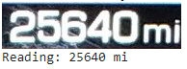
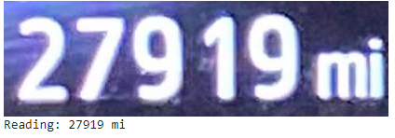
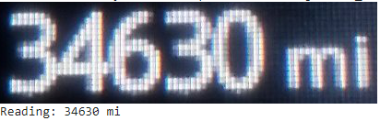
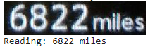
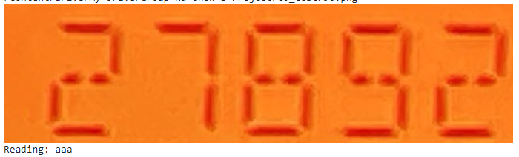
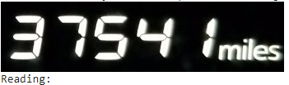
Cropping Images & Applying OCR - Derrick
OCR(Optical Character Recognition)
Allows users to recognize text within images
Filters allow us to identify odometer mileage
Utilized Pytesseract a python wrapper for Google’s Tesseract-OCR
Extracted Bounding Box from filtered images and applied it to unfiltered images
Cropped bounding Box Areas
Performed OCR on cropped area
The OCR produced mixed results

Slide 12
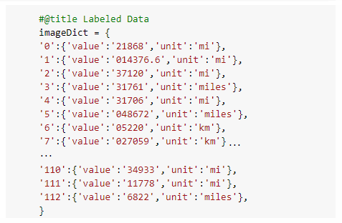
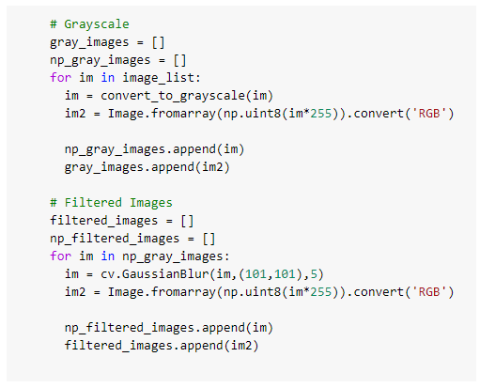
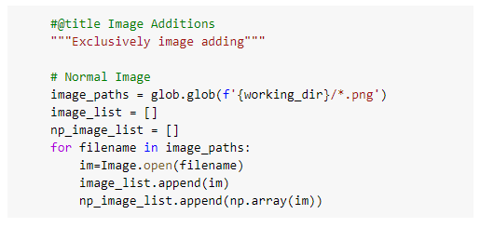
Snippets of methods used - Austin
(Put pictures here)
Notes:
Austin - So here’s some of the labeling and creation of data. Derrick and I divided the work on labeling the values and units used for each image in the dataset. Derrick also worked on converting the images to grayscale and performing a gaussian blur on them which improved it’s accuracy during training.

Slide 13
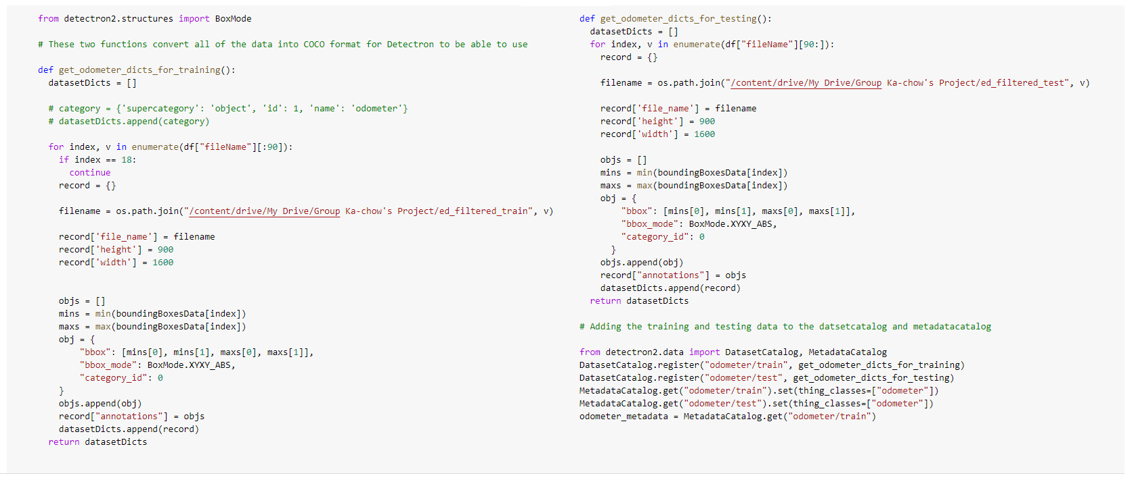
Snippets of methods used - Nick
(Put pictures here)

Slide 14
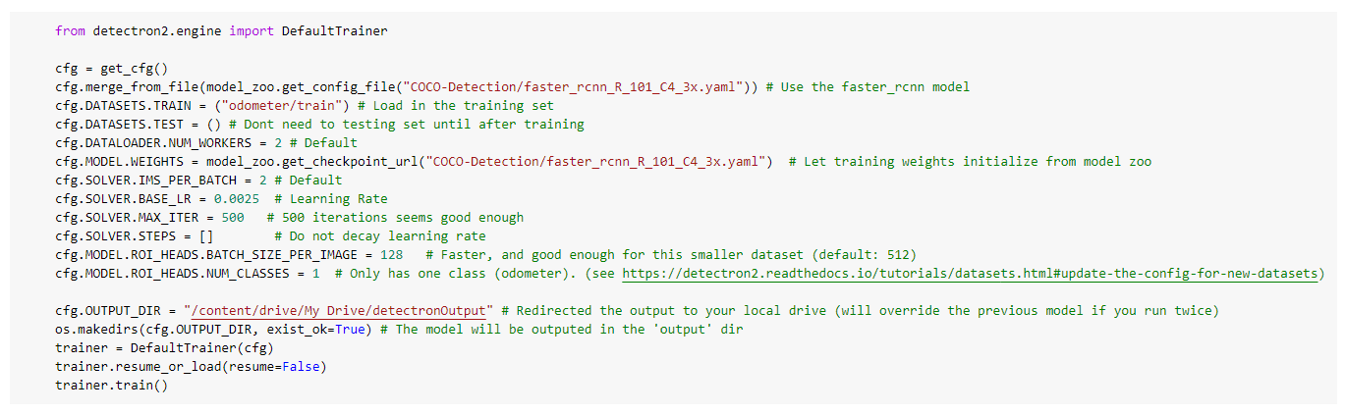
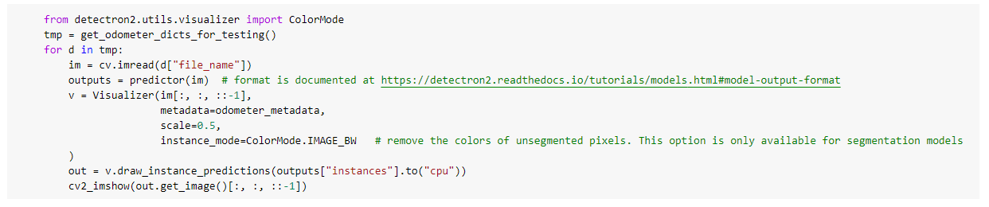
Snippets of methods used - Austin
Notes:
Austin - This snippet of code at the top sets up all the information needed to start training the data set. This includes initializing the weights in the model, picking the learning rate, setting the batch size. We set the max iterations to 500 since it seemed good enough for the small dataset we were provided.
The second snippet visualizes the programs predictions and shows it’s level of confidence in what the odometer reading is which can be seen in this next slide.

Slide 15
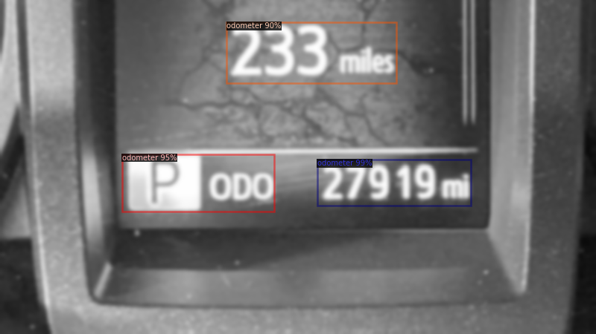
Snippets of methods used - Austin
Notes:
Austin - As you can see in the bottom right corner, the correct odometer reading is given a 99% accuracy. Because it is greater than all other confidence readings, it predicts that this is the correct odometer reading and uses the OCR to return the reading as 27, 919 miles.

Slide 16
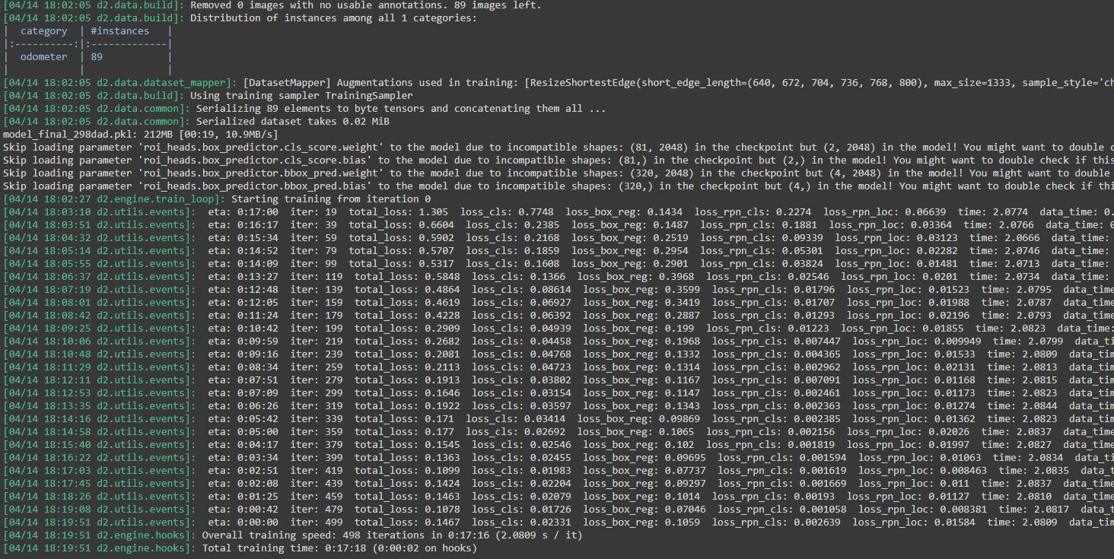
Model Running Output -Ed

Slide 17
Differences between the Researched Methods - Nick
Automatic Bounding-Box-Labeling Method of Occluded Objects in Virtual Image Data
Mileage Extraction From Odometer Pictures for Automating Auto Insurance Processes
Multi-Digit Number Recognition from Street View Imagery Using Deep Convolutional Neural Networks

Slide 18
What Worked Well in Our Method - Ed & Austin
Labeling our Training Set
Pickling The Data
Utilizing Detectron2 on Testing Set
Extracting Bounding Box Coordinates
Performing Pytesseract OCR
Why did we use Detectron2 over Yolov5?
Notes:
Austin (Pickle) - As we mentioned before we labeled all the data in the images by units used in the display and the value on the odometer. We also pickled this data alongside the normal, grayscale, and blurred images all into one file.
Ed (Testing Set) - Detectron2 had a very easy to implement way of making predictions for our testing set and then visualizing those predictions, the results came out in a COCO format so we were able to extract all the important information, such as bounding box coordinates quickly and easily
Austin (Pytesseract) - Pytesseract is what we used to take the odometer value from the image and put it into text. It was as simple as just pushing the image into it and having it return the text.
Austin (Yolov5) - So as we’ve mentioned before, we decided we’d try out two different methods to train our dataset, one being Yolov5 and the other being Detectron2. Yolov5 passes each image once into a fully convolutional neural network and trains itself off of those images. At first it seemed like it shouldn’t cause any issues since it’s able to differentiate between many objects and we were only looking for odometer readings. Unfortunately things didn’t work out that way and the predictions for the images just weren’t showing up.
Ed (Detectron) - While Austin was working on getting Yolov5 and Derrick was helping debug, I started messing around with Detectron2 and noticed they had pretty good documentation and a getting started tutorial. Detectron2 works by first setting up a Dataloader and formatting your data into COCO format, that data then gets passed into a pretrained model and then used for predictions.

Slide 19
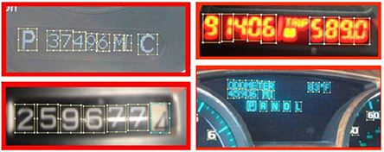
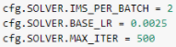
Further Optimizations/Improvements - Derrick
There are quite a few ways that we could improve our model
Larger Training Dataset
Better Chosen Parameters
More Iterations
Different OCR method or utilize a Single Shot Detector for characters
Credit: Mileage Extraction From Odometer Pictures for Automating Auto Insurance Processes by Glenn Fung and Shailesh Acharya

Slide 20
Group Contributions - Everyone
Adam - Research, Main contributor to presentation slides, formatting, team support :)
Ed - Detectron2, Hyperparameters, Bug fixing
Austin - Yolov5, writing and pickling data on the images, creating a bounding box program we used before RCNN
Nick - Research, helped with slides, verified project requirements were met
Derrick - Labeling, Research, Bounding Box Extraction, OCR
Nathan - Research, helped with cropping images for pytesseract, and helped create slides.

Slide 21
Questions
Thank You!
Notes:
Nick

